Slide 1

POWERPOINT
2016-2022
Strategic Complaints Management and Analysis in Financial Services in U.S
Nothing in this world no wounds people can really heal yourself，only yourself
Yan-Ping(Gina) Yu

Slide 2

C ontents
01.
RESEARCH MOTIVATION &
DATA SOURCES
04.
DATA ANALYSIS & VISUALIZATION
02.
FLOW CHART
05.
PROBLEM SOLVING
03.
DATA CLEANING
06.
Market insights & Conclusion
.
.
.
.
.
.
.
.
.
.
.
.
.
.
.
.
.
.
.
.
.
.
.
.
.
.
.
.
.
.
.
.
.
.
.
.
.
.
.
.
.
.
.
.
.
.
.
.
.
.
.
.
.
.
.
.
.
.
.
.
.
.
.
.
.
.
.
.
.
.
.
.
.
.
.
.
.
.
.
.
.
.
.
.
.
.
.
.
.
.
.
.
.
.
.
.
.
.
.
.
.
.
.
.
.
.
.
.
.
.
.
.
.
.
.
.
.
.
.
.
.
.
.
.
.
.
.
.
.
.
.
.
.
.
.
.
.
.
.
.

Slide 3

1
RESEARCH MOTIVATION &
DATA SOURCES
PART ONE

Slide 4
RESEARCH MOTIVATION
Personal Background
Boost Products & Services Quality
Foreign Language | Quantitative Finance
Help finance institution to identify what kinds of products and services need to be improved and how to improve.
Provide markets insights
Enhance brands’ image
Reveal the financial markets trends, driving finance institutions to do decision making and reducing potential complaints risks in the future.
Discover how finance institution can avoid negative comments and boost overall positive brand impression.

Slide 5
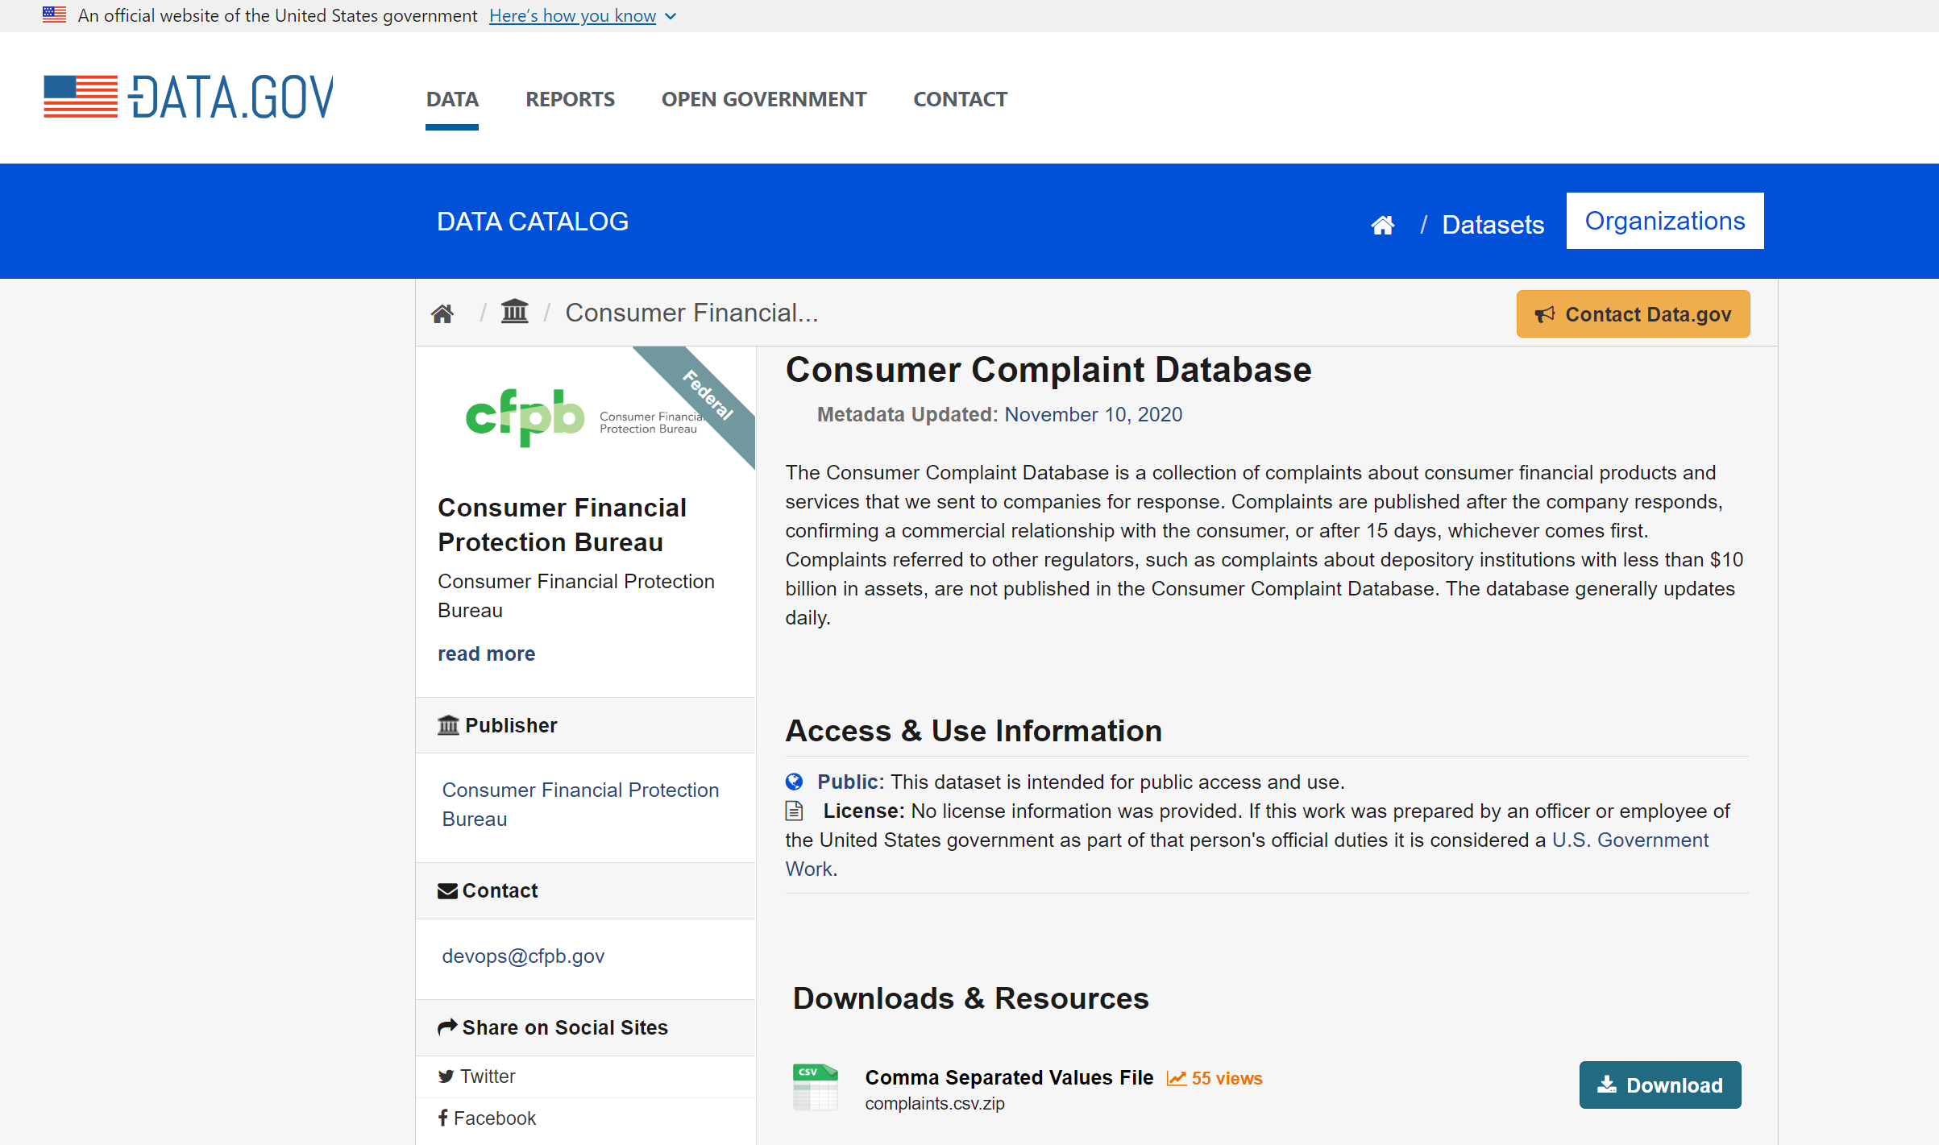
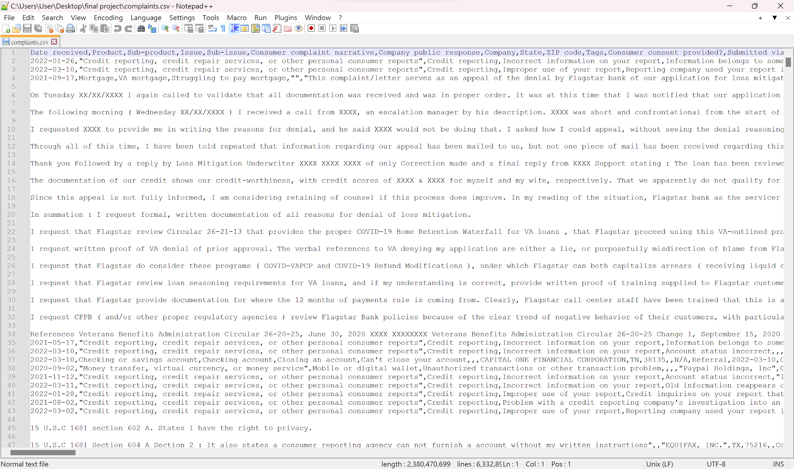
DATA SOURCES
https://catalog.data.gov/dataset/consumer-complaint-database

Slide 6
2
FLOW CHART
PART TWO

Slide 7

PROCESS
06
Provide Insights
Beginning
FLOW
STEPS
05
Data visualization through Python
Identify topic and analysis targets
01
04
Data selection and data analysis using MySQL + Python
Data collection
&
Data cleaning using Python pandas
02
03
Input data into MySQL to conduct further analysis

Slide 8

DATA CLEANING
PART THREE

Slide 9
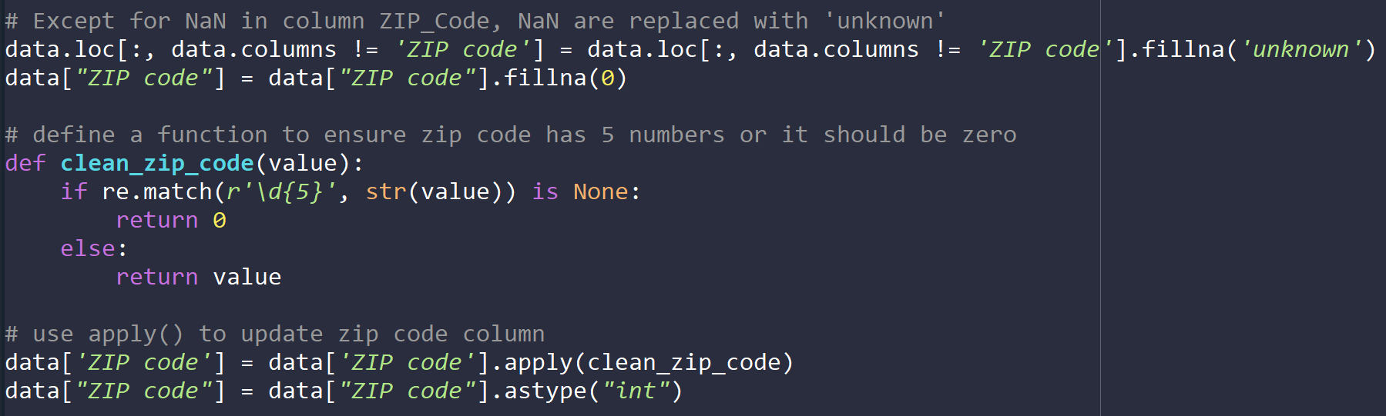
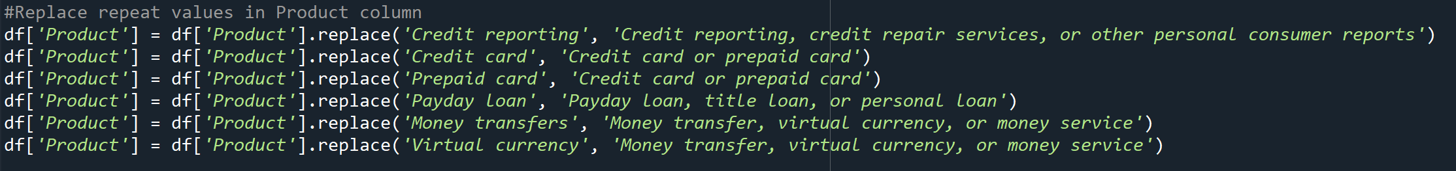
Through Python
Drop columns not will be used
Transform types of column Complaint ID
Fill NA
Transform types of column ZIP code using Regular Expression
Replace
Repeated values

Slide 10
4
DATA ANALYSIS & VISUALIZATION
PART FOUR

Slide 11
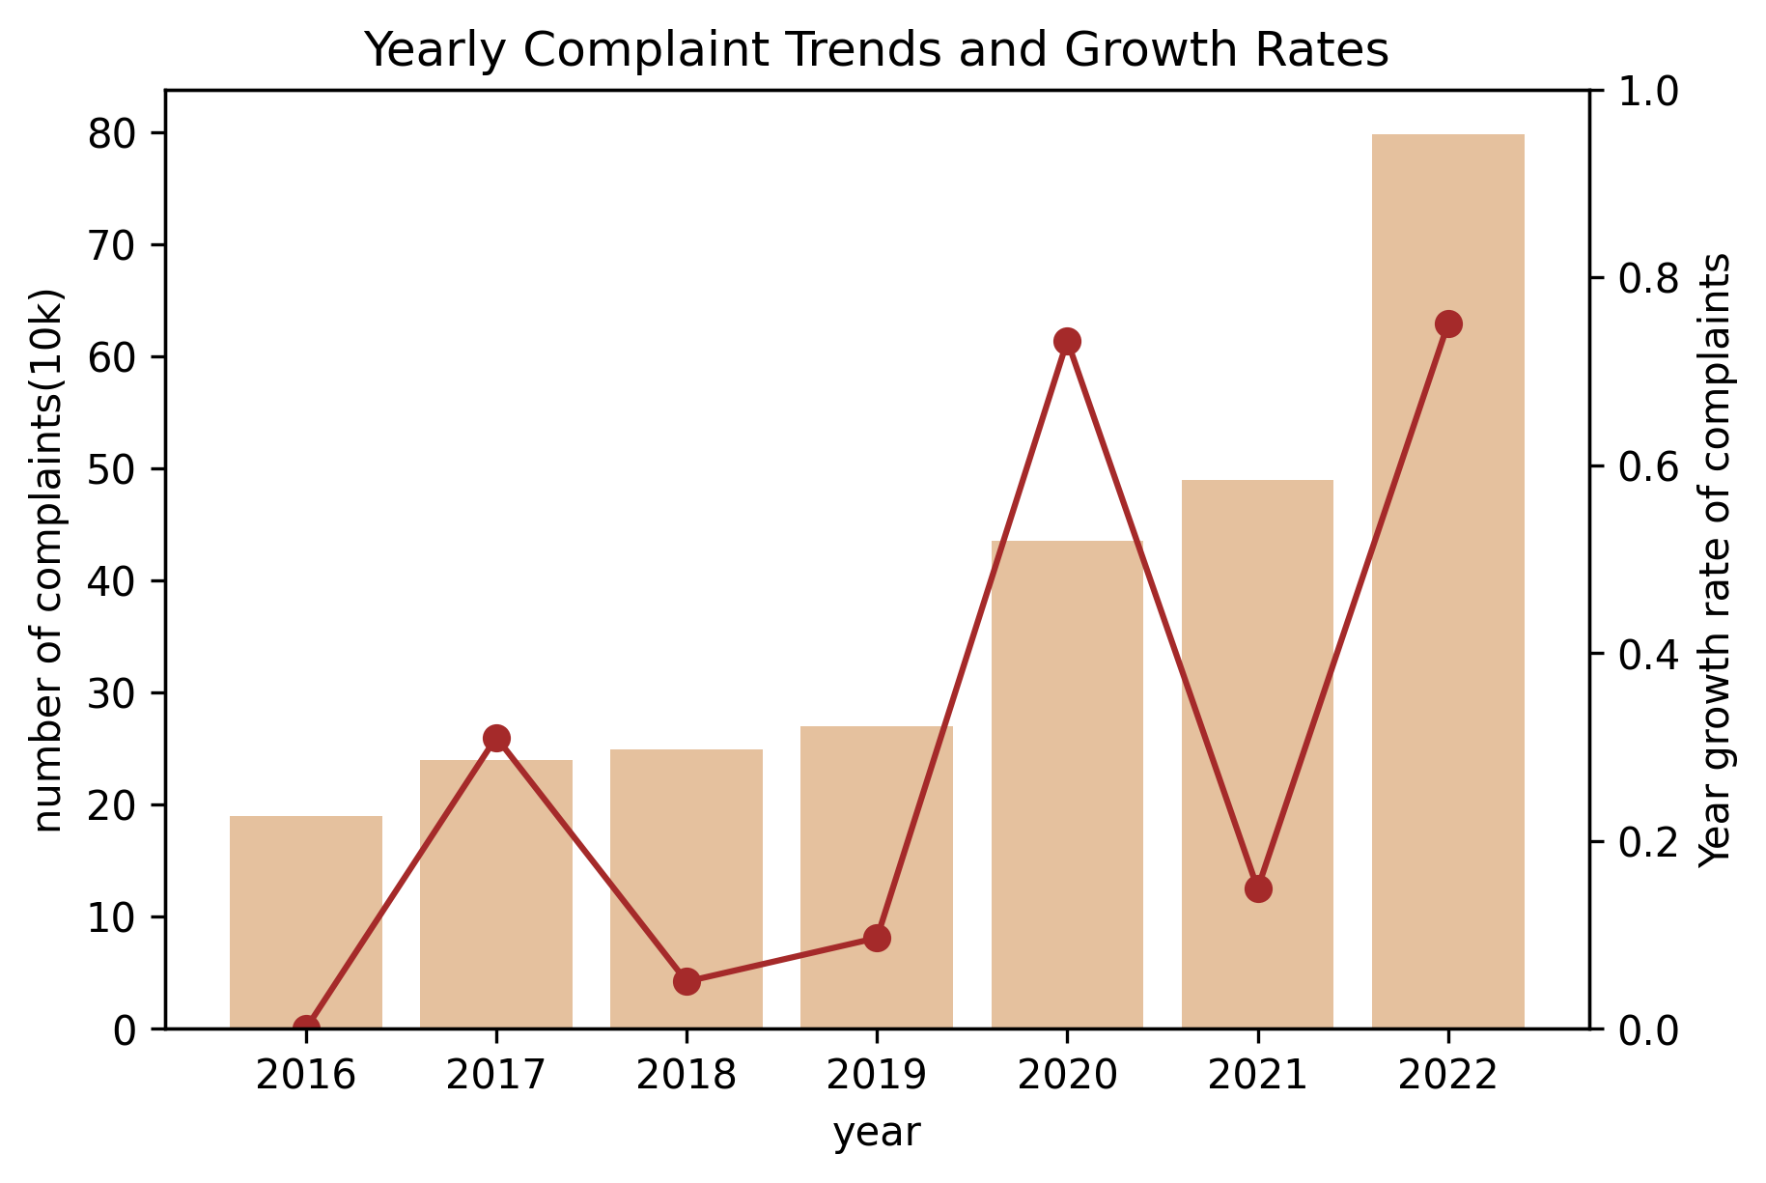
How are the
overall markets trends of complaints to financial industries in USA?
Why?
Number of complaints per year increases
Yearly growth rate of complaints fluctuates
Notes:
每年抱怨總數：這是一個絕對數量，反映了消費者對金融產品和服務不滿意的具體數量。這個數量的增加可能意味著消費者對金融產品和服務的不滿越來越多，或者消費者對於如何表達不滿越來越熟練。
年增率：這是一個相對數量，反映了抱怨數量的變化速度。如果年增率正在增加，那麼這可能意味著消費者對金融產品和服務的不滿越來越快速地增加。如果年增率正在減少，那麼這可能意味著抱怨的增長速度正在減緩。疫情影響：2019年底開始的COVID-19全球大流行可能導致了消費者對金融服務的需求和態度出現重大變化。例如，由於社交距離和封鎖措施，許多消費者可能不得不更多地依賴線上金融服務，這可能導致更多的抱怨。此外，疫情也可能導致消費者的經濟壓力增加，從而導致對金融機構的抱怨增加。

Slide 12
Reasons for Number of complaints per year increases
National Underbanked Rate and Use of Nonbank Financial Products and Services Declines
National Unbanked Rate Drops to Record Low
Mobile Banking use Continues to Increase
Product
Credit card Credit reporting Bank account or service Mortgage Debt collection Payday loan
Other financial service Consumer Loan Money transfers Student loan Prepaid card
Virtual currency Checking or savings account Money transfer, virtual currency, or money service
Credit reporting, credit repair services, or other personal consumer reports Credit card or prepaid card
Payday loan, title loan, or personal loan Vehicle loan or lease
https://www.fdic.gov/news/press-releases/2022/pr22075.html
Notes:
National Unbanked Rate Drops to Record Low. An estimated 4.5 percent of U.S. households were “unbanked” in 2021, meaning that no one in the household had a checking or savings account at a bank or credit union. This represents approximately 5.9 million U.S. households, compared to 7.1 million in 2019.
National Underbanked Rate and Use of Nonbank Financial Products and Services Declines. An additional 14.1 percent of households, or 18.7 million, were underbanked in 2021, meaning they had a bank account but used nonbank financial products and services during the year. Banked households’ use of key nonbank financial products and services that classify a household as underbanked declined by about one third between 2017 and 2021.
Mobile Banking use Continues to Increase: The use of mobile banking increased sharply among banked households between 2017 (15.1 percent) and 2021 (43.5 percent), and was the most prevalent primary method of account access. Use of a bank teller declined but remained prevalent for certain segments of the population.

Slide 13
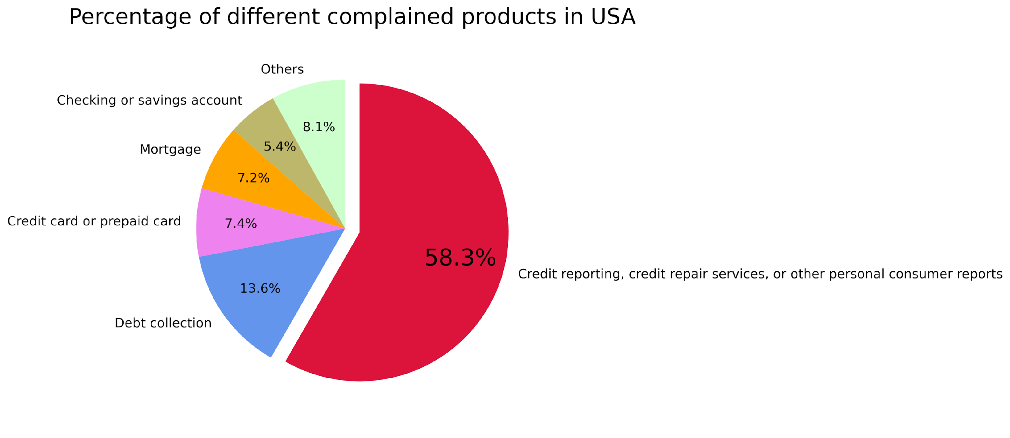
Percentage of different complained products and services in USA
TOP 5
1. Credit issues
2. Debt collection
3. Credit card or
prepaid card
4. Mortgage
5. Checking or
savings account
Notes:
接下來我想了解美國人對美國金融機構各產品的抱怨數在總抱怨數中的的比例，所以我繪製了圓餅圖，可以看出金融機構有關信用的產品與服務是收到最多抱怨的，甚至超過抱怨總數的一半。
那收到第二至第四多抱怨數的產品分別為債務收取、信用卡或預付卡、房屋抵押貸款、支票以及儲蓄帳戶。
那繪製完這張圓餅圖之候，我也想說看看美國各區域的人民對各區域金融機構不同產品的抱怨筆數所造成的各項抱怨產品佔比是否會不同
１．信用產品:錯誤的帳戶，錯誤的帳戶數字等等
2. 債務收取(Debt Collection)：債務收取的抱怨可能來自於多種不公平或騷擾的收款行為，包括不適當的通訊方式、收取不正確金額的債務。
3. 房屋抵押貸款(Mortgage)：貸款申請過程困難，或是消費者可能對貸款的費用、利率或條款感到困惑。
4. 信用卡或預付卡(Credit card or prepaid card)：費用、利率、信用限額、欺詐交易等。

Slide 14
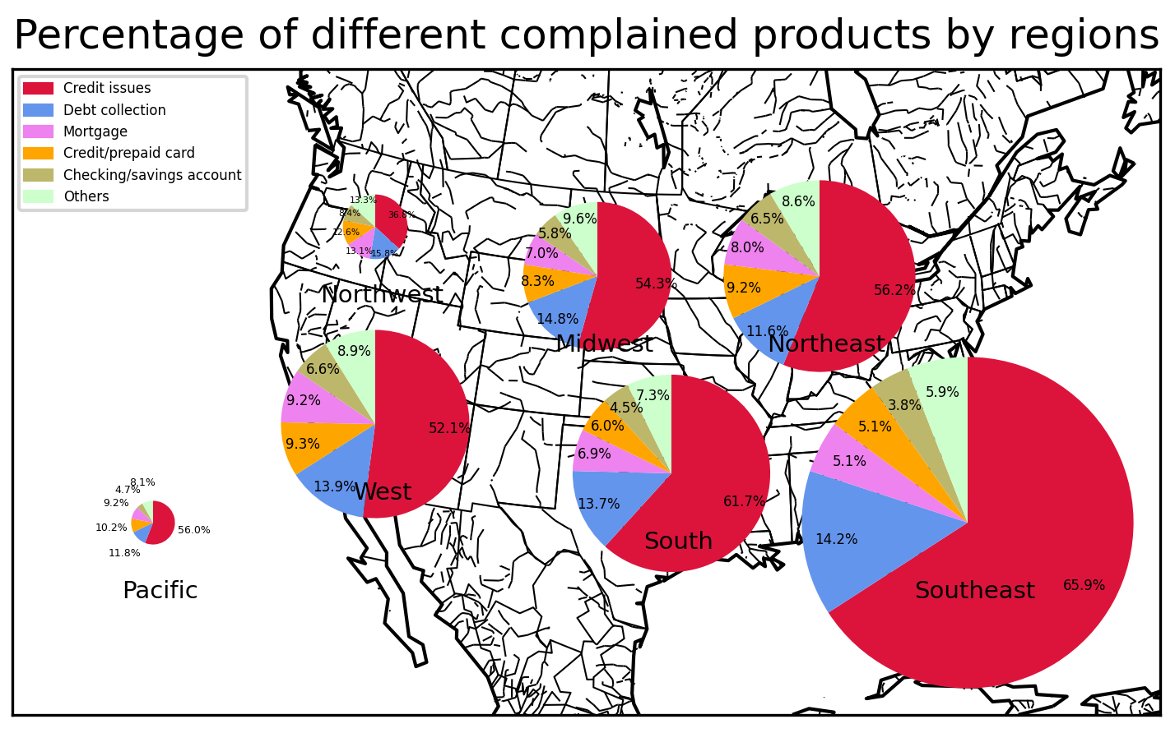
What are the complained financial products and services
in different regions in USA?
1. Pie chart size =>
complaints amount
2. Credit issues make up the largest proportion of the all pie charts
Notes:
那接下來呢，根據資料表有產品、美國各州的欄位，我就用python畫出了這張圖
這張圖是我根據地理、經濟等因素將美國各州劃分成七個區域
那圓餅圖大小代表各區消費者總抱怨數量的多寡。所以可以看到東南區域的圓圈最大，金融機構收到的總抱怨數最多
那每個圓餅圖的不同顏色就是該區域被抱怨的不同金融產品與服務的占比
那從各區圓餅圖我們可以觀察到，所有區域的信用產品與服務的抱怨佔所有產品抱怨的比例最多，也就是紅色的部分。

Slide 15

Northwest:
Credit issues v.s
Debt collection v.s
Mortgage
v.s
Credit/prepaid card
Don't aim for success if you want it ; ajust do a what you love an and believe in, and it will come naturally.
Notes:
那這邊也可以注意到西部區域的圓餅圖各產品佔比與其他區域不太一樣。就是你看其他區域紅色的部分都佔了一半以上，但西部區域卻只有36%。而粉紫色與橘色區塊分別是房屋抵押貸款、信用卡預付卡抱怨相比其他區域卻高出許多，那原因可能是西部區域只包括了華盛頓和奧勒岡，那這兩個地區的生活成本很高，以及這個區域有比較高的借貸傾向，因此居民對於此類的金融產品抱怨數量會更多一些。

Slide 16
Percentage of different complained products in USA
Comprehensive!
Universality!
High usage rate
+
Financial pressure
Notes:
整體pie chart和各區域pie charts相似:
信用產品與服務涵蓋的範圍太廣泛了，例如錯誤的信用報告：像是不正確的付款記錄或舊的資訊未被適當地移除，或者身份或帳戶被盜竊等等
普遍性：美國幾乎所有的成年人都會有信用報告，那他們的信用報告是跟他們生活環環相扣的，像是信用報告中的錯誤可能會導致消費者信用評分下降，從而影響他們獲得貸款或其他金融產品的能力。因此，導致信用產品抱怨的數量較多。
至於債務收取、信用卡或預付卡、房屋抵押貸款、支票以及儲蓄帳戶等為各地區抱怨的第二至第五名，可能的原因包括：
高使用率：這些產品和服務在消費者中的使用率很高，因此相關的問題和抱怨也可能會較多。
金融壓力：債務收取、抵押貸款和信用

Slide 17
5
PROBLEM SOLVING
PART FIVE

Slide 18

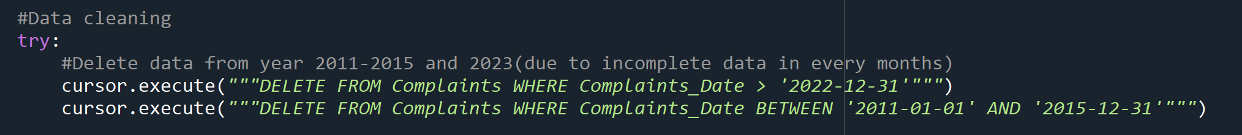
Compromise
Narrowing down the time dimension
3.8 million rows ----🡪 2.9 million rows

Slide 19
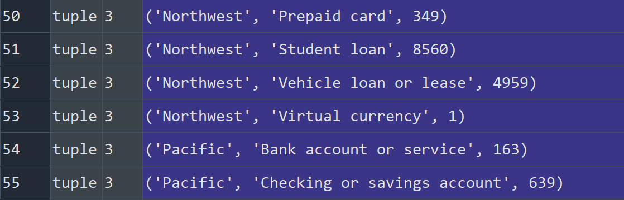
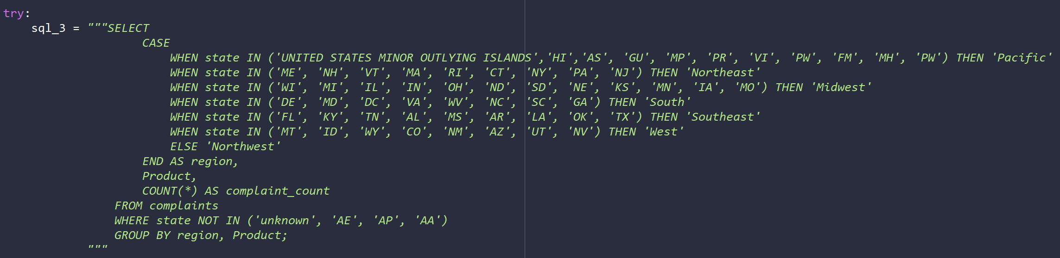
SQL Advanced Selection
SELECT CASE WHEN COLUMN IN … THEN …

Slide 20
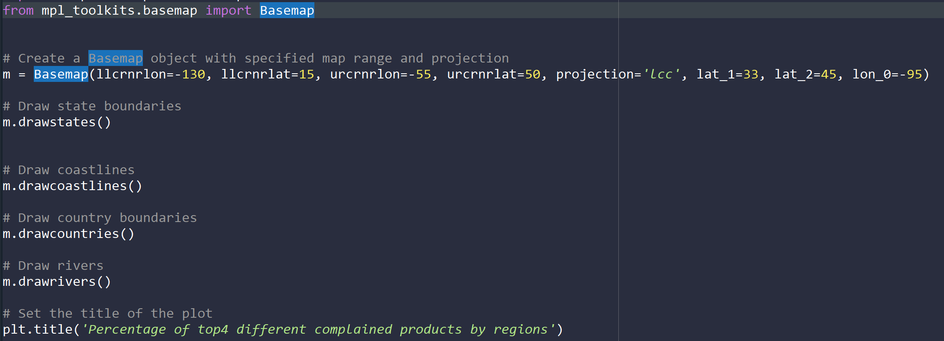
Draw USA map + pie charts
Adobe Illustrator
USA map: Basemap

Slide 21
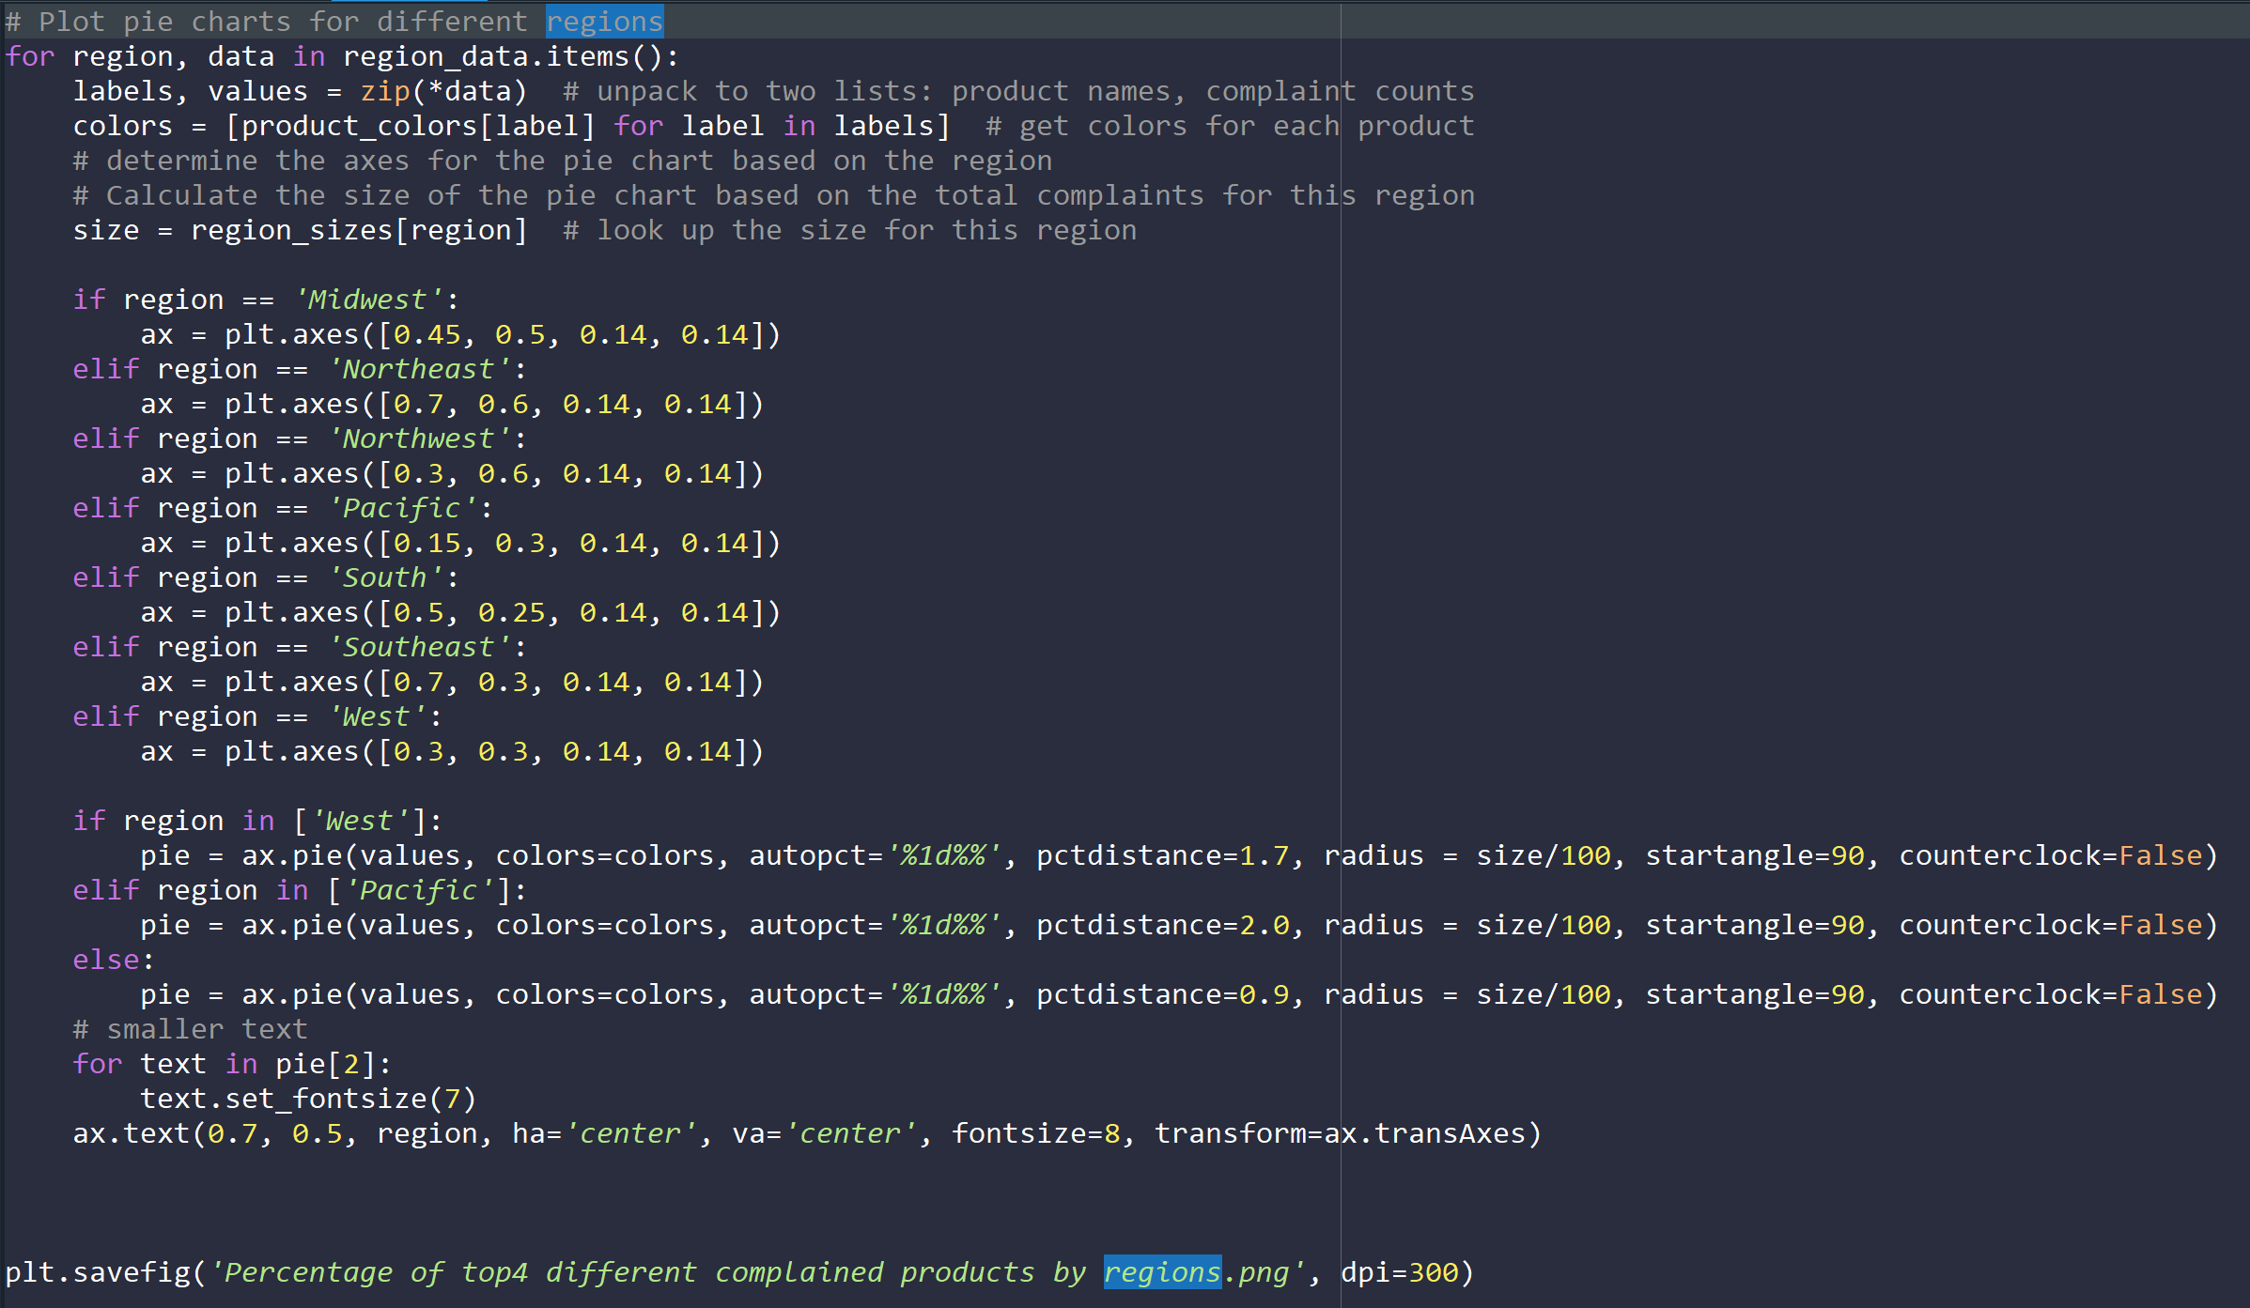

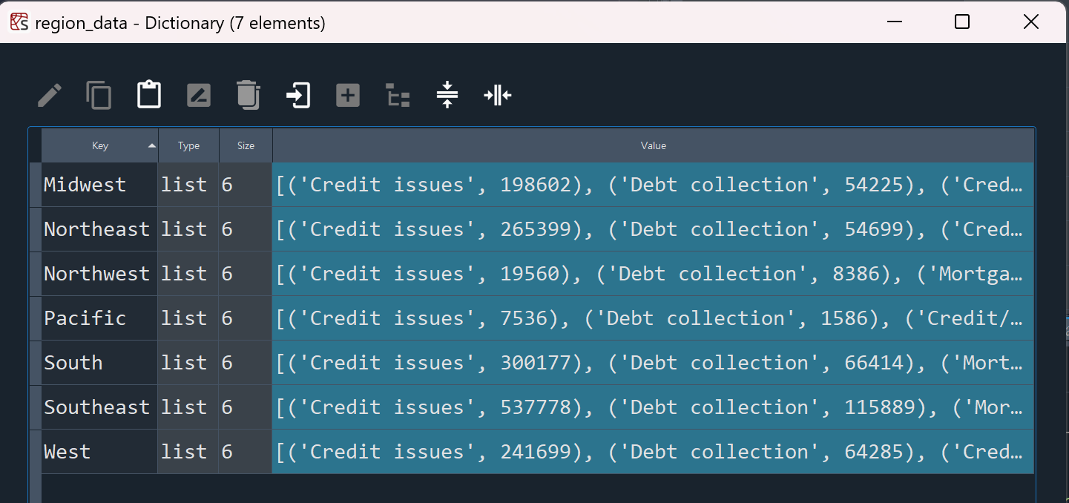
COLD
STYLE TEMPLATE
Adobe Illustrator
Four short words sum up what has lifted most successful individuals above the crowd: a little bit more. experience as your reference. Never put off what you can do today until tomorrow. You cannot improve your past, but you can improve your future.

Slide 22

Insights & Conclusion
PART SIX

Slide 23
TRENDS & HOW TO IMPROVE
More people use financial products and service nowadays
-> Risk of a surge in complaints
-> Financial institutions should enhance the abilities to deal with more complaints cases, such as hiring more cs workers, introducing AI cs, etc
1.
Credit issues account for over half of the total complaints
-> Post a significant risk to the reputation of financial institutions
-> If Financial institutions want to reduce complaints rates and improve brands’ images rapidly, they should address credit issues first
2.
Different regions have different background factors to affect the complained products
(eg. Southeast region - unemployment rate)
-> The financial institution can provide funds to support the enterprises to offer more job opportunities -> Unemployment rate declines -> credit issues complaints reduce
3.
4.
General solving rules: credit issues > debt collection > mortgage > credit/prepaid card
===> raise transparency, improve risk management capabilities, etc

Slide 24

THANKS
FOR WATCHING

